Slide 1
Azure - The building blocks of a modern cloud application
Shawn Weisfeld
shawn@shawnweisfeld.com
http://www.shawnweisfeld.com

Slide 2







About Me
Founder of UserGroup.tv
Technical Evangelist at Microsoft
Adjunct Professor at Florida Institute of Technology

Slide 3


Watch User Group presentations for FREE online!
All the topics you care about
Including:
Agile
C#
Entity Framework
HTML5
MVC
Silverlight
XAML
jQuery
and Much More!
Miss a User Group meeting?
Forget something that you learned?
Want to see content from a User Group not in your area?
Want to share with a buddy?
We know you cannot make it to every User Group meeting,
that is why we post them online for you!
We now have over 425 presentations online
That is over 100 GB of video
New Content added all the time!
Presentations from the thought leaders on the topic.
For new content announcements
@UserGroupTV
http://www.UserGroup.tv

Slide 4
Agenda
Services
Choices
Tips

Slide 5










Services
Big Data
Database
Storage
Traffic
Messaging
Caching
Identity
Media
CDN
Networking
Mobile

Slide 6
11 Categories
Compute
Web & Mobile
Data & Storage
Analytics
Internet of Things
Networking
Media & CDN
Hybrid Integration
Identity & Access Management
Developer Services
Management

Slide 7
40 services . . . and growing
Virtual Machines
Cloud Services
Batch
RemoteApp
App Service
Web Apps
Mobile Apps
Logic Apps
API Apps
API Management
Notification Hubs
Mobile Engagement
SQL Database
DocumentDB
Redis Cache
Storage
StorSimple
Azure Search
HDInsight
Machine Learning
Stream Analytics
Data Factory
Event Hubs
Virtual Network
ExpressRoute
Traffic Manager
Media Services
CDN
BizTalk Services
Service Bus
Backup
Site Recovery
Azure Active Directory
Multi-Factor Authentication
Visual Studio Online
Application Insights
Scheduler
Automation
Operational Insights
Key Vault

Slide 8
Compute
Virtual Machines
Provision Windows and Linux Virtual Machines and applications in minutes
Cloud Services
Create highly available, infinitely scalable cloud applications and APIs
Batch*
Run large-scale parallel and batch compute jobs
RemoteApp
Deploy Windows client apps in the cloud, run on any device

Slide 9
Web & Mobile
App Service
Create web and mobile apps for any platform and any device
Web Apps
Quickly create and deploy mission critical Web apps that scale with your business
Mobile Apps
Build and host the backend for any mobile app
Logic Apps
Automate the access and use of data across clouds without writing code
API Apps
Easily build and consume Cloud APIs
http://weblogs.asp.net/scottgu/announcing-the-new-azure-app-service

Slide 10
Web & Mobile
API Management
Publish APIs to developers, partners and employees securely and at scale
Notification Hubs
Scalable, cross-platform push notification infrastructure
Mobile Engagement*
Data-driven user engagement platform to maximize performance

Slide 11
Data & Storage
SQL Database
Managed Relational SQL Database-as-a-service
DocumentDB
Managed NoSQL document database-as-a-service
Redis Cache
High throughput, low latency data access to build fast and scalable applications
Storage (table, blob, queue)
Durable, highly available and massively scalable cloud storage
StorSimple
Hybrid cloud storage for enterprises, reduces costs and improves data security
Azure Search
Fully-managed search-as-a-service

Slide 12
Analytics
HDInsight
Provision managed Hadoop clusters
Machine Learning
Powerful cloud-based predictive analytics
Stream Analytics*
Real-time stream processing
Data Factory*
Orchestrate and manage data transformation and movement
Event Hubs
Ingest, persist, and process millions of events per second

Slide 13
Internet of Things
Event Hubs
Receive telemetry from millions of devices
Stream Analytics *
Real-time data stream processing from millions of IoT devices
Machine Learning
Powerful cloud based predictive analytics tool to enable predictive maintenance
Notification Hubs
A scalable, mobile-push notification engine for quickly sending millions of messages.

Slide 14
Networking
Virtual Network
Provision private networks, optionally connect to on-premises datacenters
ExpressRoute
Dedicated private network fiber connections to Azure
Traffic Manager
Load balance incoming traffic for high performance and availability

Slide 15
Media & CDN
Media Services
Encode, store, and stream video and audio at scale
CDN
Deliver content to end-users through a robust network of global data centers

Slide 16
Hybrid Integration
BizTalk Services
Seamlessly integrate the enterprise and the cloud
Service Bus
Connect across private and public cloud environments
Backup
Simple and reliable server backup to the cloud
Site Recovery
Orchestrate protection and recovery of private clouds

Slide 17
Identity & Access Management
Azure Active Directory
Synchronize on-premises directories and enable single sign-on
Multi-Factor Authentication
Safeguard access to your data and apps with an extra level of authentication

Slide 18
Developer Services
Visual Studio Online
Plan, build and ship software, all from one place
Application Insights
Detect and solve problems to continuously improve web apps

Slide 19
Management
Scheduler
Run your jobs on simple or complex recurring schedules
Automation
Simplify cloud management with process automation
Operational Insights*
Collect, search and visualize machine data from on-premises and cloud
Key Vault*
Safeguard and maintain control of keys and other secrets

Slide 20

Ask yourself…

Slide 21

Is this the right tool for the job?

Slide 22



Scale up vs scale out?

Slide 23


Who is going to maintain it?
Packaged Software
Infrastructure
(as a Service)
Platform
(as a Service)
Software
(as a Service)
You manage
Applications
Applications
Applications
Applications
Data
You manage
Data
Data
Data
Runtime
Runtime
Runtime
Runtime
Managed by vendor
You manage
Middleware
Middleware
Middleware
Managed by vendor
Middleware
O/S
O/S
O/S
O/S
Virtualization
Virtualization
Managed by vendor
Virtualization
Virtualization
Servers
Servers
Servers
Servers
Storage
Storage
Storage
Storage
Networking
Networking
Networking
Networking
Your Car
Rental Car
Taxi

Slide 24
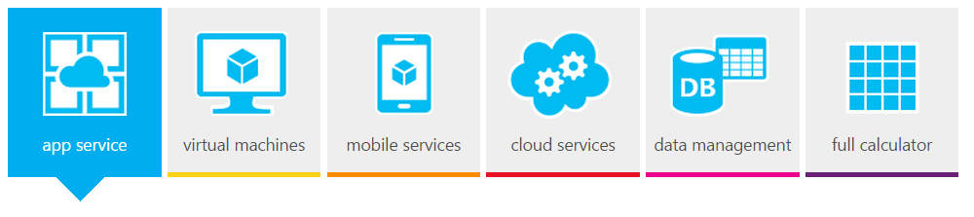
How much is it going to cost
Azure Pricing Calculator
http://azure.microsoft.com/en-us/pricing/calculator/

Slide 25

Choices

Slide 26
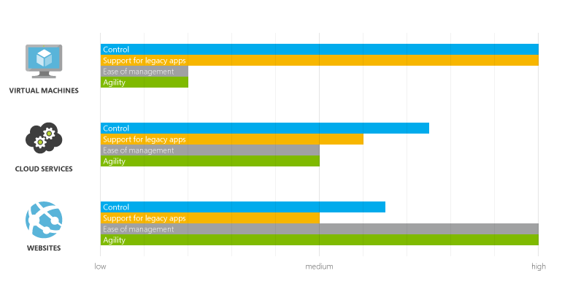
Azure Websites, Cloud Services, and Virtual Machines comparison
http://azure.microsoft.com/en-us/documentation/articles/choose-web-site-cloud-service-vm/

Slide 27
Structured Data at rest
Storage Blobs
Storage Tables
Relational Storage (SQL Server PaaS or IaaS)
Document DB

Slide 28
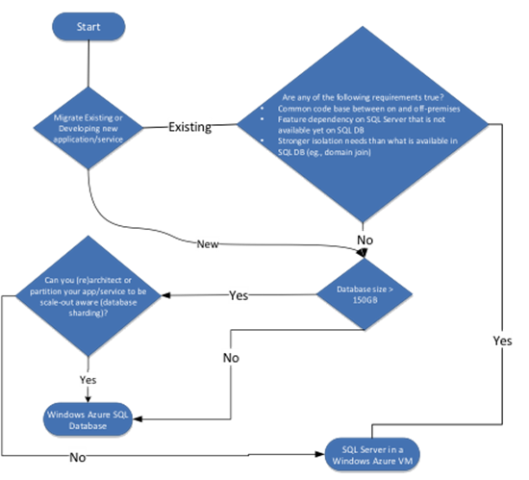
Relational Data
Choosing between SQL Server in Windows Azure VM & Windows Azure SQL Database
http://azure.microsoft.com/blog/2013/02/14/choosing-between-sql-server-in-windows-azure-vm-windows-azure-sql-database/

Slide 29
SQL Server tools
SQL Database Migration Wizard
http://sqlazuremw.codeplex.com/
Azure SQL Database DTU Calculator
http://dtucalculator.azurewebsites.net/

Slide 30

Azure Queues and Service Bus Queues
https://msdn.microsoft.com/en-us/library/azure/hh767287.aspx

Slide 31


Slide 32


Shawn’s Top Tips

Slide 33

Know your limits
http://azure.microsoft.com/en-us/documentation/articles/azure-subscription-service-limits/

Slide 34

Load Test
VSO Load Test - https://www.visualstudio.com/en-us/get-started/load-test-your-app-vs.aspx
Penetration Test Approval Form - https://security-forms.azure.com/penetration-testing

Slide 35

Don’t reinvent the wheel
http://msdn.microsoft.com/en-us/library/dn589799.aspx

Slide 36

Stage Deployments
Cloud Services - http://azure.microsoft.com/en-us/documentation/articles/cloud-services-nodejs-stage-application/
WebSites - http://azure.microsoft.com/en-us/documentation/articles/web-sites-staged-publishing/

Slide 37

Telemetry is key
http://blogs.msdn.com/b/kwill/archive/2014/12/02/windows-azure-diagnostics-upgrading-from-azure-sdk-2-4-to-azure-sdk-2-5.aspx

Slide 38

Its better with two
http://azure.microsoft.com/en-us/support/legal/sla/

Slide 39

http://www.microsoft.com/en-us/server-cloud/roadmap/recently-available.aspx

Slide 40
Thank you! Your Feedback is Important
Rate My Talk & Download Slides + Code!
http://tinyurl.com/RateShawn
Contact Information
Email: shawn@shawnweisfeld.com
Blog: http://www.shawnweisfeld.com
Twitter: @shawnweisfeld

Slide 41

© 2014 Microsoft Corporation. All rights reserved. Microsoft, Windows, Windows Vista and other product names are or may be registered trademarks and/or trademarks in the U.S. and/or other countries.
The information herein is for informational purposes only and represents the current view of Microsoft Corporation as of the date of this presentation. Because Microsoft must respond to changing market conditions, it should not be interpreted to be a commitment on the part of Microsoft, and Microsoft cannot guarantee the accuracy of any information provided after the date of this presentation. MICROSOFT MAKES NO WARRANTIES, EXPRESS, IMPLIED OR STATUTORY, AS TO THE INFORMATION IN THIS PRESENTATION.

